Slide 2
Reliable VPN Solutions IN
IOT Environments
JULIAN WEINBERGER | +1 (650) 316 6273 | www.ncp-e.com

Slide 3

SECURE COMMUNICATION IN IOT ENVIRONMENTS
GROWTH OF IOT ENVIRONMENTS
IOT MARKET FORECASTS VARY; ALL PREDICT ENORMOUS GROWTH POTENTIAL.
PREDICTIONS FOR 2020 RANGE FROM 12 TO 50 BILLION, UP FROM 1 BILLION IN 2010

Slide 4



SECURE COMMUNICATION IN IOT ENVIRONMENTS
IMPLEMENTATION APPROACHES FOR VPN AND IOT
VPN provided by a carrier via 3G/4G LTE
VPN provided by a router via WiFi/HotSpot
VPN Software
No additional hardware/services required
Traffic encrypted on the device

Slide 5









SECURE COMMUNICATION IN IOT ENVIRONMENTS
VPN Connections
Connection type depends on the machine application
Automatic, or always on
  e.g, surveillance camera
Connection on demand, via command line or API
  e.g., credit card swipe at POS terminal
Gateway
VPN
Management

Slide 6





SECURE COMMUNICATION IN IOT ENVIRONMENTS
Authenticating the connection
In the absence of human interaction, a machine needs to perform authentication steps to establish a VPN connection.
Username / Password
Soft certificates
Smartcards
Hardware / Machine
certificates
TPM

Slide 7
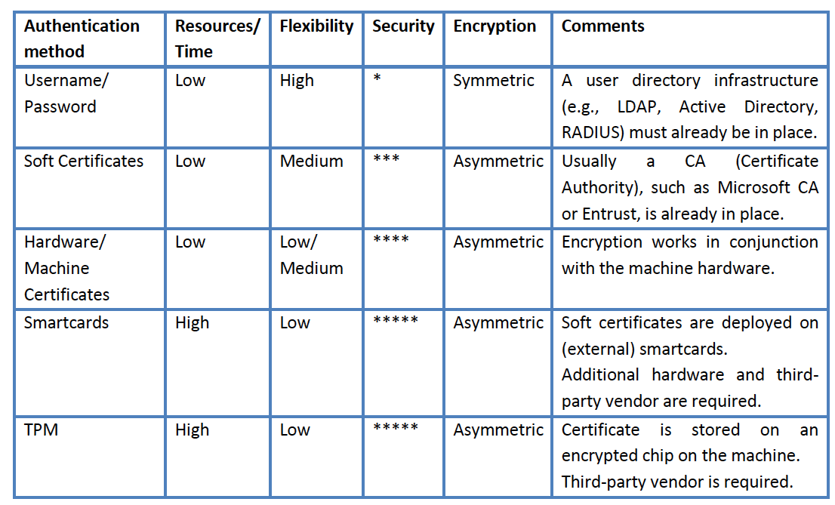
SECURE COMMUNICATION IN IOT ENVIRONMENTS
Authentication methods at a glance

Slide 8

SECURE COMMUNICATION IN IOT ENVIRONMENTS
Authentication methods
Username / Password
  Commonly stored in VPN Client on the machine
  Credentials can be information e.g. the hostname
Soft Certificates
  User certificates stored on local device
  Every machine has one certificate, which may not be unique to it

Slide 9

SECURE COMMUNICATION IN IOT ENVIRONMENTS
Authentication methods
Smartcards
  Physical external smartcard for authentication
  User certificate on external chip
  Adds another level of security
  Basis for two-factor-authentication
Machine hardware certificates
  User/soft certificates relies on machine fingerprint to bind to unique machine
  Can not be used with any other machine
  Basis for two-factor-authentication

Slide 10

SECURE COMMUNICATION IN IOT ENVIRONMENTS
Authentication methods
TPM (Trusted Platform Module)
  Smartcard build into machine, soldered onto motherboard
  Adds another level of security
  Basis for two-factor-authentication

Slide 11


SECURE COMMUNICATION IN IOT ENVIRONMENTS
Managing the Vpn Client
Full control, everywhere at any time
Rollout of software, configurations and authentication information
Configuration and software updates
VPN Management
Authentication management
Gateway
VPN
Management

Slide 12

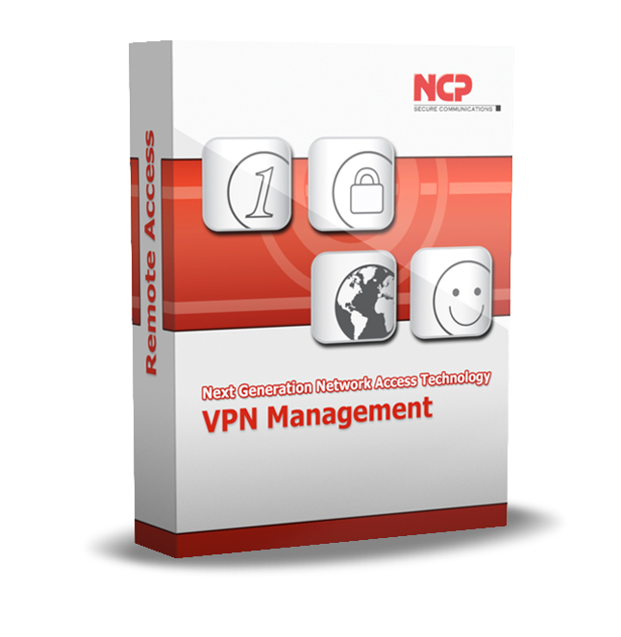
SECURE COMMUNICATION IN IOT ENVIRONMENTS
VPN Central Management - the Single Point of Administration
USER directory
Endpoint Policy
Certification
Authority (CA)
Software deployment
VPN Gateway
RADIUS Server

Slide 13

SECURE COMMUNICATION IN IOT ENVIRONMENTS
Summary
VPN has been the basis for securing IoT environments for some time
Automatic, always-on vs. connection on demand is based on application type
Consider resources, flexibility and security when selecting authentication method(s)
Look for solutions that enable automatic rollout of VPN configurations, certificates and updates

Slide 14







Scenario
Fleet Management – Connected Cars
Operational information for 10,000 vehicles
NCP Secure
Client
IIoT
Gateway
IIoT
Management
Onboard Unit with
IIoT Remote Gateway
Data Center
lan
Wifi

Slide 15




Scenario
Tramway-Information system
Information directly on info displays and ticket vending machines
IIoT
Gateway
IIoT Remote Gateway
IIoT
Management
Info display
IIoT Remote Gateway
Ticket Vending
Machine
Data Center
lan
3G/4G
wifi

Slide 16





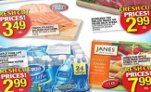
Scenario
Secure IN-Store digital display for product promotion
Digtial signage at grocery stores or pharmacies
Grocery store, medical Pracitce, Pharmacy…
IIoT
Gateway
Content
IIoT
Management
Content Management System
Service Technician
Data Center
lan
3G/4G
wifi

Slide 17


SECURE COMMUNICATION IN IOT ENVIRONMENTS
About NCP engineering – Network Communication Products
30 YEARS REMOTE ACCESS – SECURE COMMUNICATION EXPERTISE
Nuremberg - Germany
headquarters
founded 1986
100 % privately owned
San francisco - California
established 2010
Clearwater - Florida
established 2015
global support team
global network of sales partner
international OEM partnerships
worldwide more than 30,000 customers

Slide 18
Thank you For your Attention
JULIAN WEINBERGER | +1 (650) 316 6273 | www.ncp-e.com

