Slide 1
IT & OT Security
RAMI: How to identify the weak points in industrial use cases of a cloud
Markus Bartsch
Notes:
Achten auf 16:9 Modus!

Slide 2
RAMI
Reference Architecture Model Industry 4.0
Life Cycle & Value Stream
IEC 62890
Hierarchy Levels
IEC 62264 // IEC 61512
Business
Functional
Layers
Information
Communication
Integration
Connected World
Asset
Enterprise
Work Centers
Station
Type
Control Device
Development
Instance
Field Device
Maintenance
Usage
Product
Production
Maintenance
Usage

Slide 3
RAMI
Life Cycle Step „Production“
Life Cycle & Value Stream
IEC 62890
Hierarchy Levels
IEC 62264 // IEC 61512
Business
Functional
Layers
Information
Communication
Integration
Connected World
Asset
Enterprise
Work Centers
Station
Type
Control Device
Development
Instance
Field Device
Maintenance
Usage
Product
Production
Maintenance
Usage

Slide 4
RAMI
Life Cycle Step „Production“
Life Cycle & Value Stream
IEC 62890
Hierarchy Levels
IEC 62264 // IEC 61512
Business
Functional
Layers
Information
Communication
Integration
Connected World
Asset
Enterprise
Work Centers
Station
Type
Control Device
Development
Instance
Field Device
Maintenance
Usage
Product
Production
Maintenance
Usage

Slide 5
RAMI - Production
OT
ICS / SCADA
(Office-) IT
Hierarchy Levels
IEC 62264 // IEC 61512
Business
Functional
Layers
Information
Communication
Integration
Asset
Product
Station
Enterprise
Field Device
Control Device
Work Centers
Connected World

Slide 6
RAMI – Production
Cloud Security
OT
ICS / SCADA
(Office-) IT
Hierarchy Levels
IEC 62264 // IEC 61512
Cloud
Business
Functional
Layers
Information
Communication
Integration
Asset
Product
Station
Enterprise
Field Device
Control Device
Work Centers
Connected World

Slide 7
RAMI
Cloud Security + Enterprise Security (ISMS)
OT
ICS / SCADA
(Office-) IT
Hierarchy Levels
IEC 62264 // IEC 61512
Cloud
Business
Functional
Layers
Information
Communication
Integration
Asset
Product
Station
Field Device
Control Device
Work Centers
Enterprise
ISMS (2700x)
Connected World

Slide 8
RAMI
OT Levels
OT
ICS / SCADA
(Office-) IT
Hierarchy Levels
IEC 62264 // IEC 61512
Business
Functional
Layers
Information
Communication
Integration
Asset
Product
Station
Enterprise
Field Device
Control Device
Work Centers
Connected World

Slide 9
RAMI
OT Levels
Integration

Slide 10
Industry 4.0 Component
Integration

Slide 11


Industry 4.0 Component
Integration
Communication
Asset
Thing
Administration Shell
Administration Shell
Thing
Thing
Administration Shell
Administration Shell
Thing
Thing

Slide 12
RAMI – SGAM
Difference: Life-Cycle instead of Domains
Zones
Domains
Business
Life Cycle & Value Stream
IEC 62890
Hierarchy Levels
IEC 62264 // IEC 61512
Functional
Information
Communication
Layers
Market
Business
Enterprise
Generation
Functional
Component (“Asset” + Integration)
Operation
Information
Transmission
Field
Station (+Control Device)
Layers
DER
Communication
Distribution
Process
Integration
Customer
Premises
Asset
Connected World
Enterprise
Station
Work Centers
Type
Control Device
Development
Field Device
Maintenance
Usage
Instance
Product
Production
Maintenance
Usage
Notes:
Generation = Bulk Generation
DER = Distributed Electrical Resources

Slide 13
RAMA (Draft)
Reference Architecture Model Automotive
Life Cycle & Value Stream
IEC 62890
Hierarchy Levels
Service
Layers
Functional
Information
Communication
Component
Connected World (ITS)
Infrastructure (Street)
Vehicle
Type
Domain
Development
Instance
ECU
Maint.
Operation
Field
Park
Move
Maint.

Slide 14
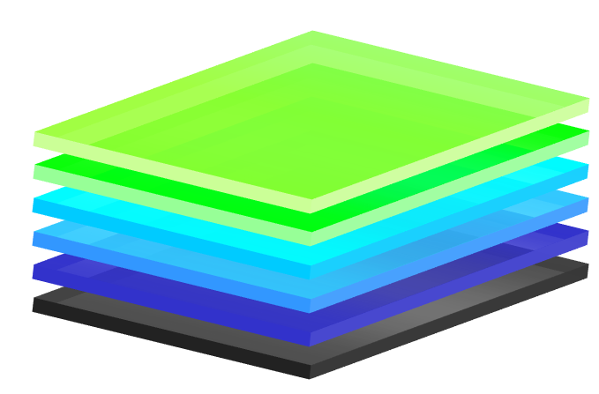
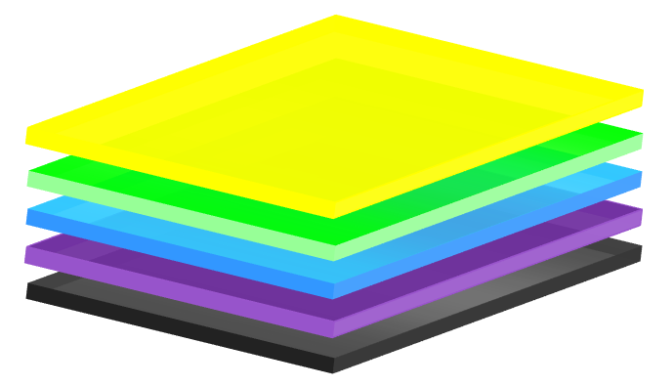
RAMA (Draft)
Referenzarchitekturmodell Automotive – Life Cycle & Value Stream
RAMI
Type
Instance
Development
Maintenance
Usage
Production
Maintenance
Usage
Type
Instance
RAMA
Operation
Development
Maintenance
Park
Move
Maintenance
Information

Slide 15
Industry 4.0 Component
Asset
Integration
Communication
Thing
Administration Shell
Administration Shell
Thing
Thing
Administration Shell
Administration Shell
Thing
Thing
I4.0 Comp’ has a unique ID

Slide 16
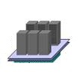







RAMI - RAMA
Central (Cloud-) Approach
Business
Functional
Information
Communication
Integration
$
Asset
AMI
M S P
Field
ECU
Domain
Vehicle
Product
Station
Infrastructure
Field Device
Enterprise
Connected World
DNP
Control Device
Work Centers
Connected World
$
ITS
Web
OEM
FW
Delivery
DIC
Radio
RCDLR
Supply
IPC
HVAC
BCM
ECM
SDM
TDM
TCM
EBCM

Slide 17

RAMI – RAMA (1)
Separation: Security Gateways
Business
Functional
Information
GW
Admin
Communication
Integration
$
Asset
M S P
Field
ECU
Domain
Vehicle
Infrastructure
Product
Station
Enterprise
Connected World
Field Device
SMGW
Control Device
Connected World
DNP
Work Centers
ID
PKI
$
ITS
Web
OEM
FW
Delivery
DIC
Radio
RCDLR
Supply
IPC
HVAC
BCM
GW
ECM
SDM
TDM
TCM
EBCM
Notes:
Auf das Produkt – das Bauteil - hinweisen

Slide 18
RAMI – RAMA (2)
Secure Applications in Control Devices
Business
Functional
Information
GW
Admin
Communication
Integration
$
Asset
M S P
Field
ECU
Domain
Vehicle
Infrastructure
Product
Station
Connected World
Field Device
Enterprise
SMGW
Work Centers
Connected World
DNP
Control Device
ID
PKI
$
ITS
Web
OEM
FW
Delivery
DIC
Radio
RCDLR
Supply
IPC
HVAC
BCM
GW
ECM
SDM
TDM
TCM
EBCM

Slide 19
RAMI – RAMA (3)
Fully integrated Security → Field Devices
Business
Functional
Information
GW
Admin
Communication
Integration
$
Asset
Field
ECU
Domain
Vehicle
M S P
Infrastructure
Station
Connected World
Product
Enterprise
Control Device
Work Centers
Connected World
SMGW
DNP
Field Device
ID
PKI
$
ITS
Web
OEM
FW
Delivery
DIC
Radio
RCDLR
Supply
IPC
HVAC
BCM
GW
ECM
SDM
TDM
TCM
EBCM

Slide 20

OT Security Integration (4)
„Smart Parts“ / Anti Piracy
Business
Functional
Information
Communication
Integration
Asset
Product
Station
Enterprise
Field Device
Work Centers
Control Device
Connected World
PKI
Web
FW
Delivery
Supply
GW

Slide 21
RAMI – 4 Sectors
Reference Architecture Model Industry 4.0
2
3
Life Cycle & Value Stream
IEC 62890
Hierarchy Levels
IEC 62264 // IEC 61512
1
Business
4
Functional
Layers
Information
Communication
Integration
Connected World
Asset
Enterprise
Work Centers
Station
Type
Control Device
Development
Instance
Field Device
Maintenance
Usage
Product
Production
Maintenance
Usage

Slide 22
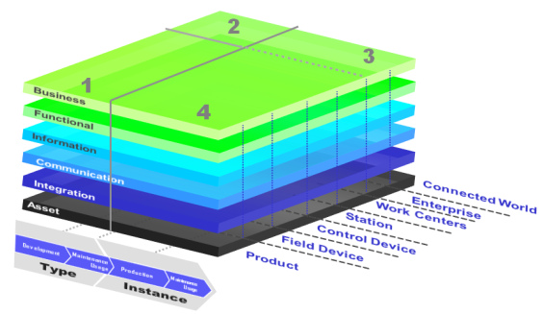
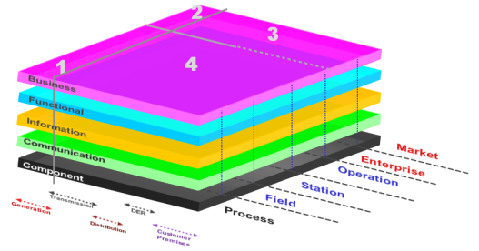
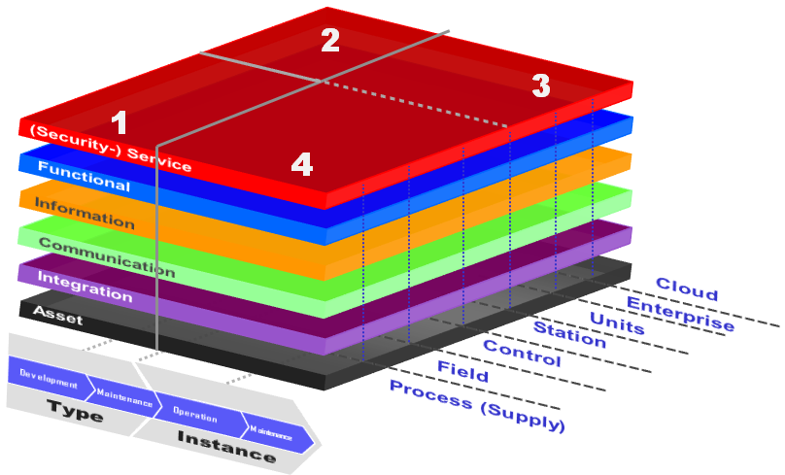
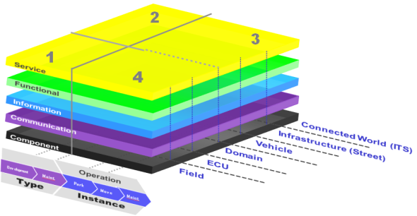
Meta Reference Architecture Model
SGAM
RAMI
MRAM
RAMA
Integration to MRAM

Slide 23
MRAM - Meta Reference Architecture Model
2
Hierarchy Levels
Life Cycle & Value Stream
IEC 62890
3
1
(Security-) Service
4
Functional
Layers
Information
Communication
Integration
Cloud
Asset
Enterprise
Units
Station
Type
Control
Development
Instance
Field
Maintenance
Process (Supply)
Operation
Maintenance

Slide 24


Thank you
TÜV Informationstechnik GmbH
Member of TÜV NORD Group
Markus Bartsch
IT Security
Langemarckstrasse 20
45141 Essen, Germany
Phone: +49 201 8999 – 616
Fax: +49 201 8999 – 666
E-Mail: m.bartsch@tuvit.de
URL: www.tuvit.net

